Slide 1

Modifying CARLA Simulator’s Radar Sensor Model and Implementing DBSCAN for Data Labelling and Machine Learning Algorithms
Research Thesis
Author : Ananya Reginald Frederick
Matriculation No. : 7207003
Supervisor : Prof. Dr. Andreas Becker
Date : 26/08/2024

Slide 2
CONTENT
Motivation and Objectives
CARLA Simulator
CARLA Pipeline
Radar Sensor Model Modification
Radar data processing
DBSCAN Clustering
Results

Slide 3
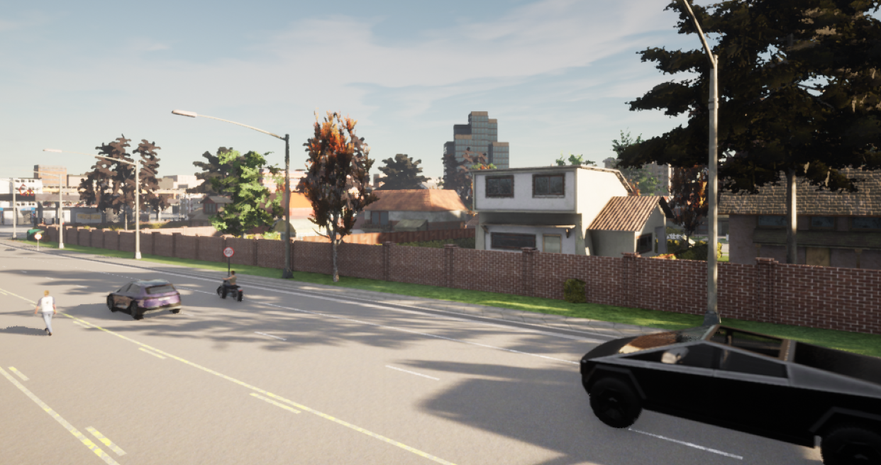
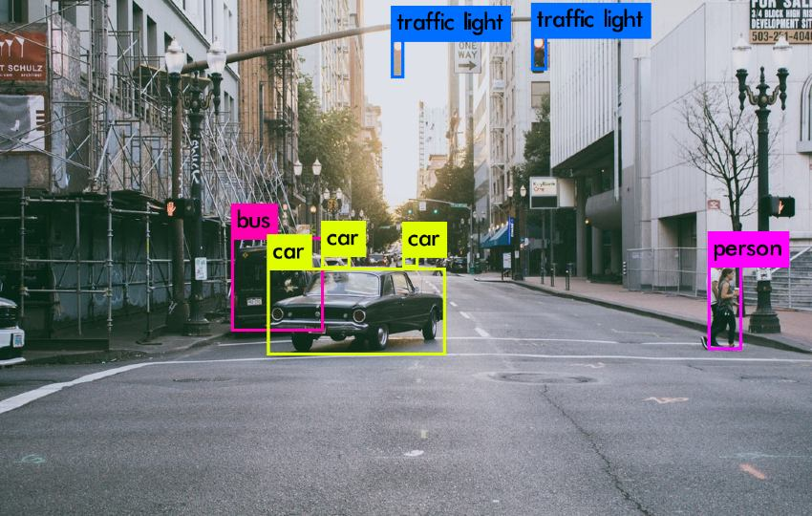
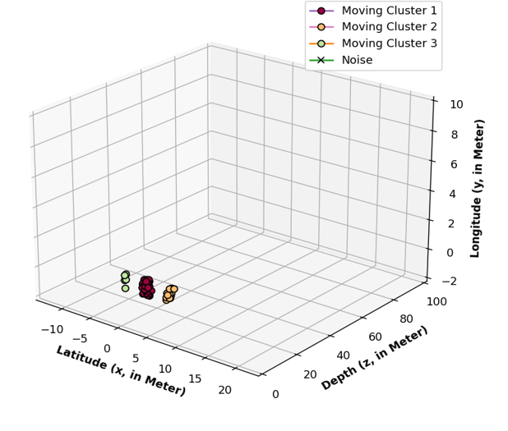
MOTIVATION
Labeled Radar data
Processing Radar data and Applying DBSCAN for ML and other Algorithms
OBJECTIVES
Understanding the process of sensor creation and the Carla pipeline
Performing an analysis of radar and lidar code
Adding a feature to the radar code that returns labeled radar data.
Creating scenarios and collecting simulated Radar data.
Filtering stationary and moving objects
Performing clustering of the data using DBSCAN

Slide 4
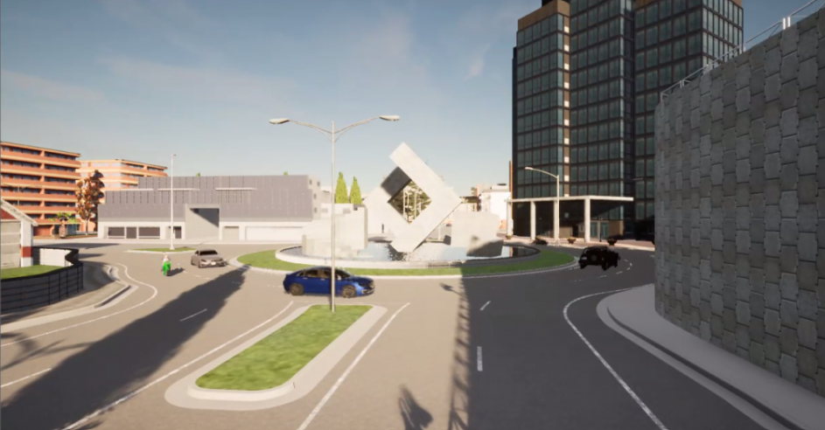
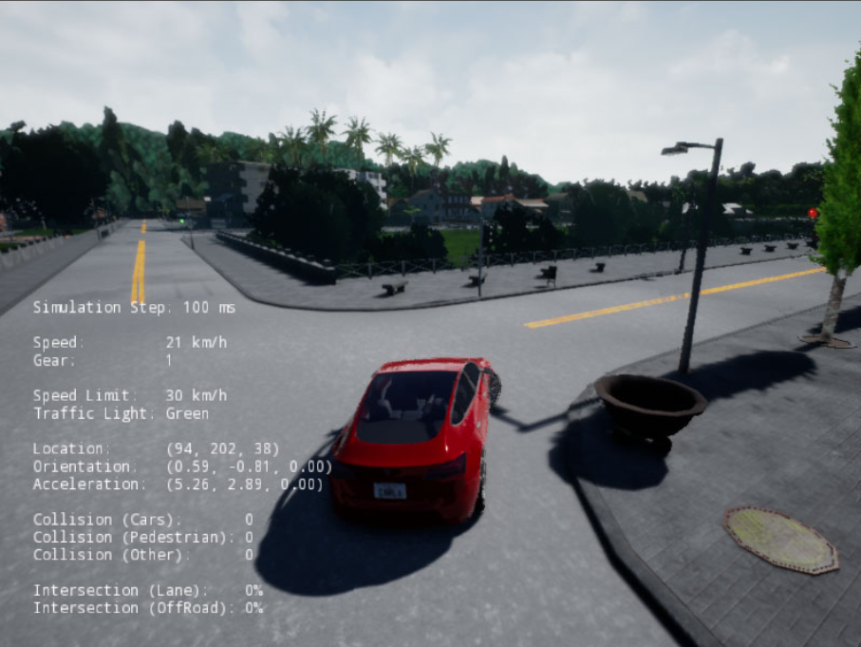
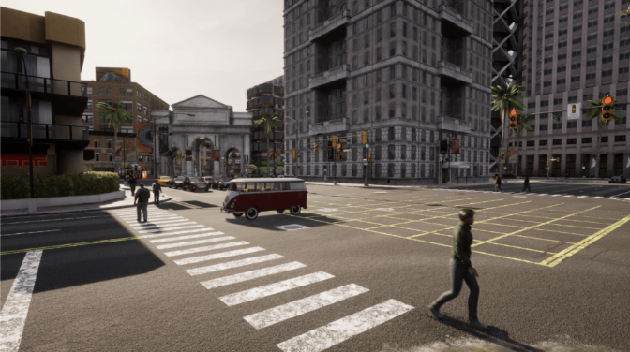
Carla Simulator
1. https://www.luffca.com/2018/07/carla-imitation-learning/
2. CARLA+: An Evolution of the CARLA Simulator for Complex Environment Using a Probabilistic Graphical Model

Slide 5
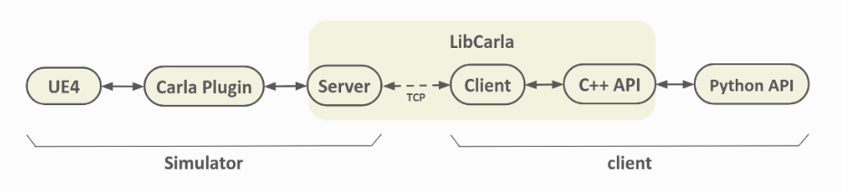
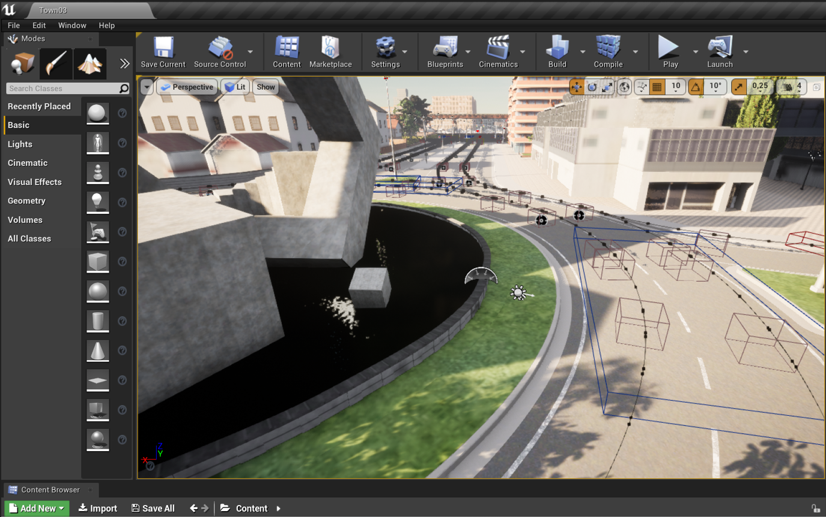


Carla Pipeline
Carla Simulator
Data Bridge
User
https://www.pngwing.com/en/free-png-zidpb
https://www.cleanpng.com/png-clip-art-ethernet-network-cables-openclipart-elect-7234085/

Slide 6
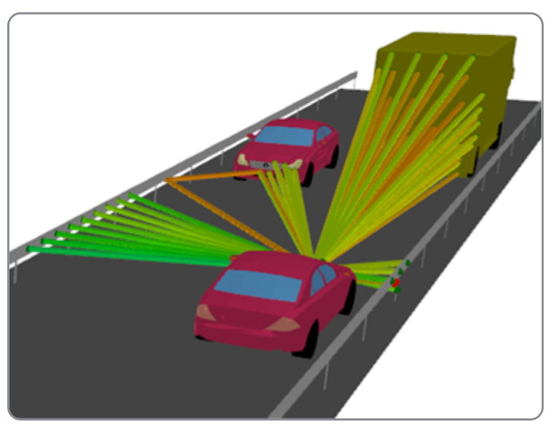
Radar Sensor Model Modification
Calculate Radar FOV
Calculate Ray Casting Information
Shoot traces and store information
Has a ray hit an object?
Loop
No
Access Episode and Actor Registry
Yes
No
Valid object in Registry?
Yes
Store Object information
https://2021.help.altair.com/2021/winprop/topics/winprop/user_guide/proman/propagation_models/time_variant_import_RCS_feko-time_variant.htm

Slide 7
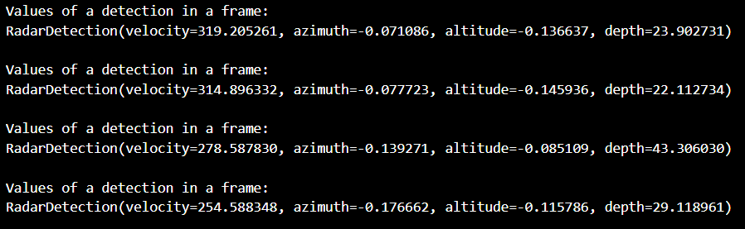
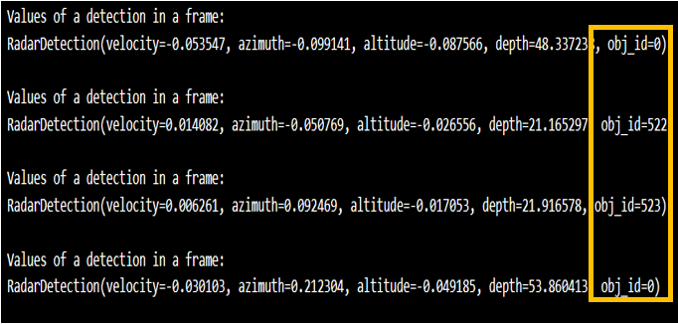
Unmodified sensor output
Modified sensor output
The radar detection from the unmodified and modified Carla simulator.

Slide 8
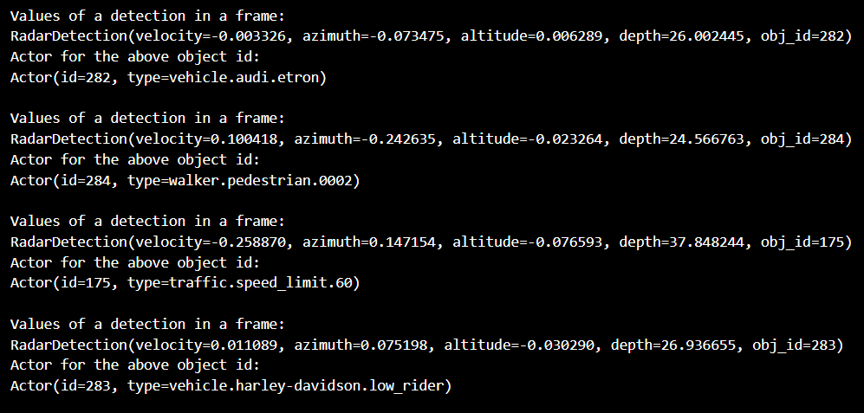
Displays the values returned by matching the Object IDs in the Actor list.

Slide 9
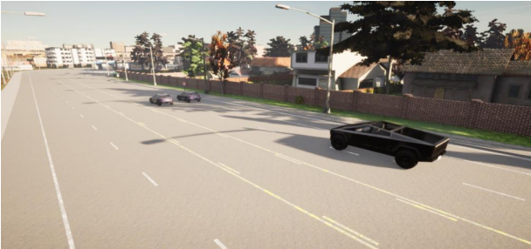
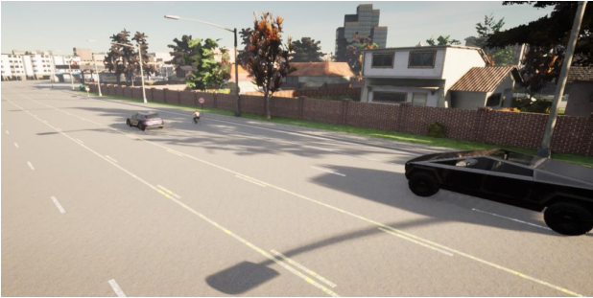
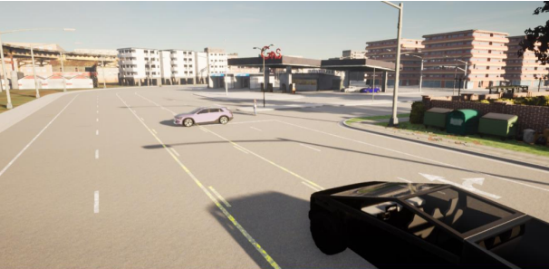
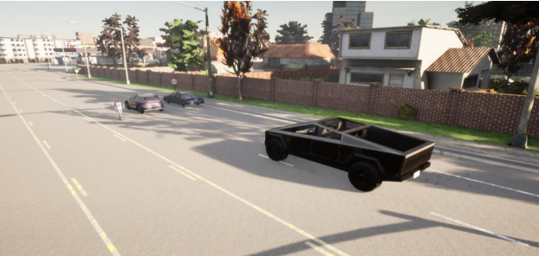
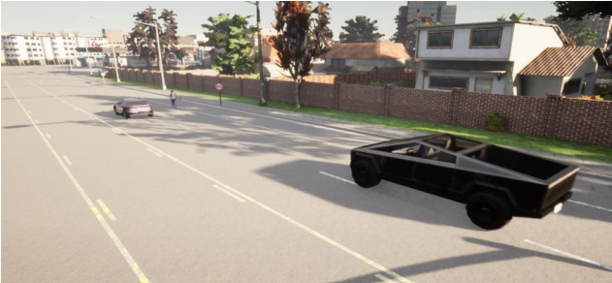
Radar data processing

Slide 10

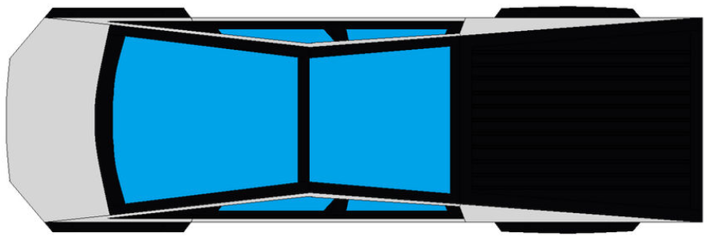


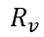


Separating Moving and Stationary objects
Read and store Sensor data
Store Ego vehicle velocity
$$R_{v}\sin{ɵ}$$
Trim Incomplete Frames
$$R_{v}\cos{ɵ}$$
$$ɵ$$
All Detections in a frame checked?
Loop
V_ego
$$R_{v}$$
Yes
No
Convert from Spherical to Cartesian Coordinate System
$$ɵ$$
Calculate Speed of Target Detection
Compare Detection Speed with Ego velocity.

Slide 11
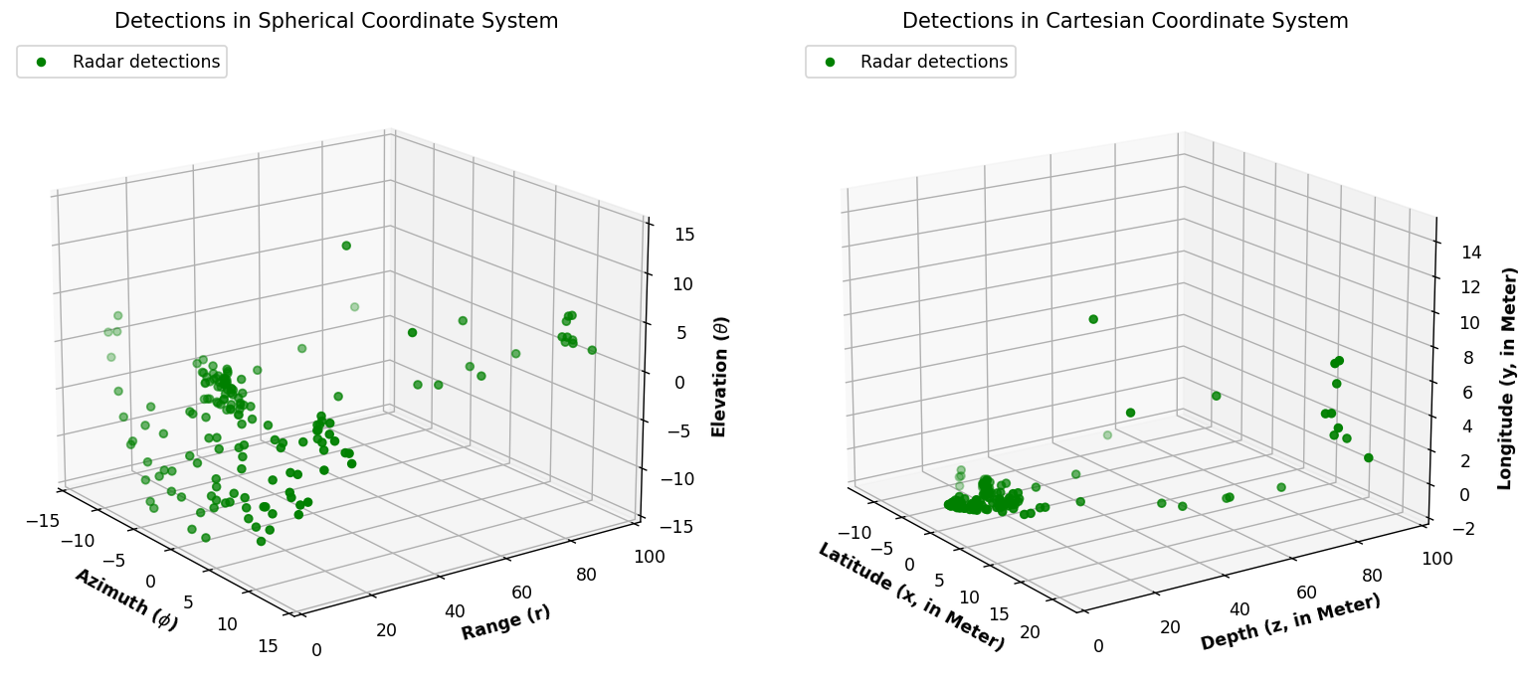

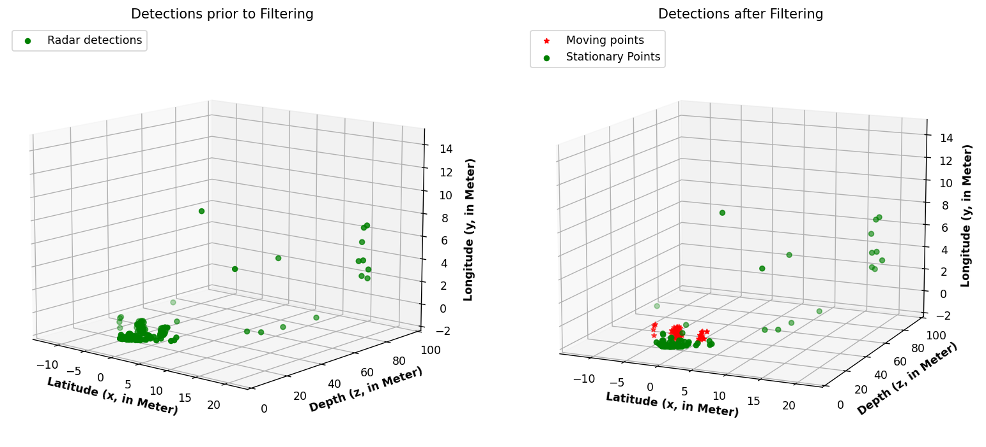
Radar data processing for detections from Scenario 4

Slide 12
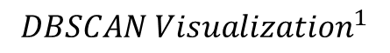
DBSCAN Clustering
minPts=4
Eps
$DBSCA{N Visualization}^{1}$
1.https://medium.com/analytics-vidhya/cluster-analysis-with-dbscan-density-based-spatial-clustering-of-applications-with-noise-6ade1ec23555

Slide 13
Applying DBSCAN Clustering
Import DBSCAN from Scikit-learn Library
Import Matplotlib Library
All frames checked?
Loop
Yes
No
Store x, y, and z coordinates in a 2D array
Apply DBSCAN and access Cluster results.
Eps = 2 and MinPts =2
Visualize data via Matlplotlib Library

Slide 14
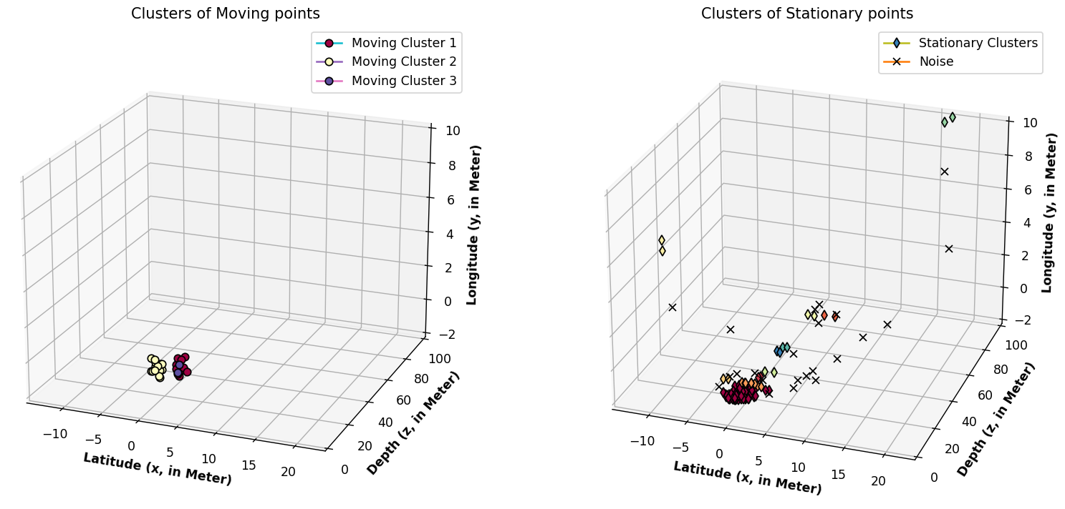
Results
Shows the clusters Identified by applying DBSCAN on the point cloud generated by Scenario 1

Slide 15
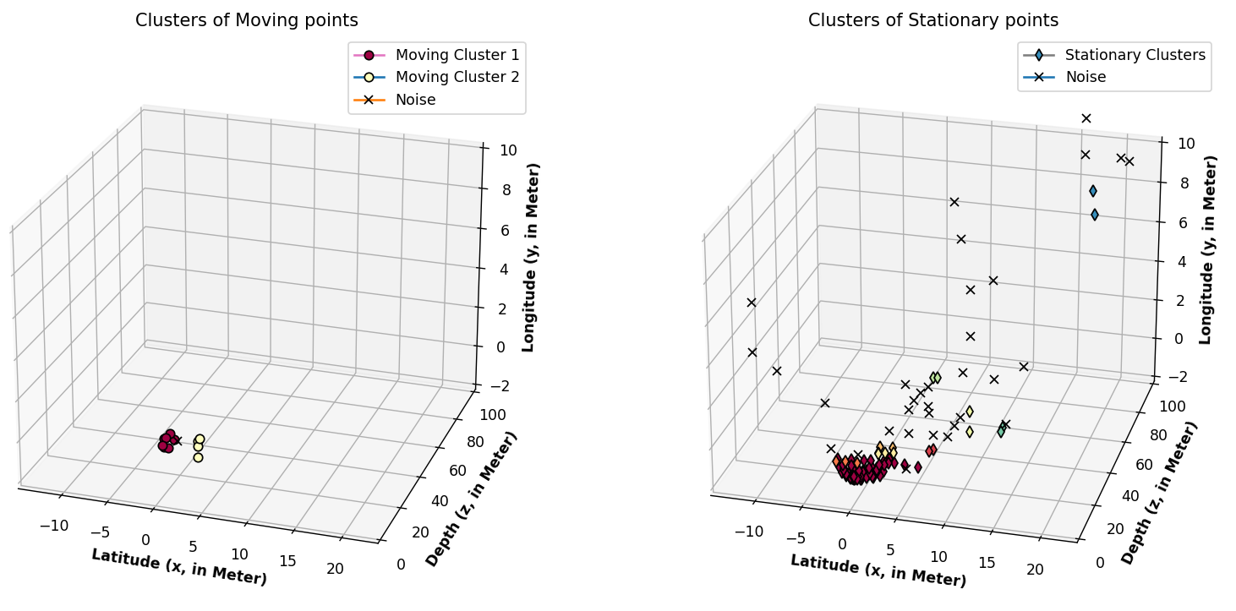
Shows the clusters Identified by applying DBSCAN on the point cloud generated by Scenario 2

Slide 16
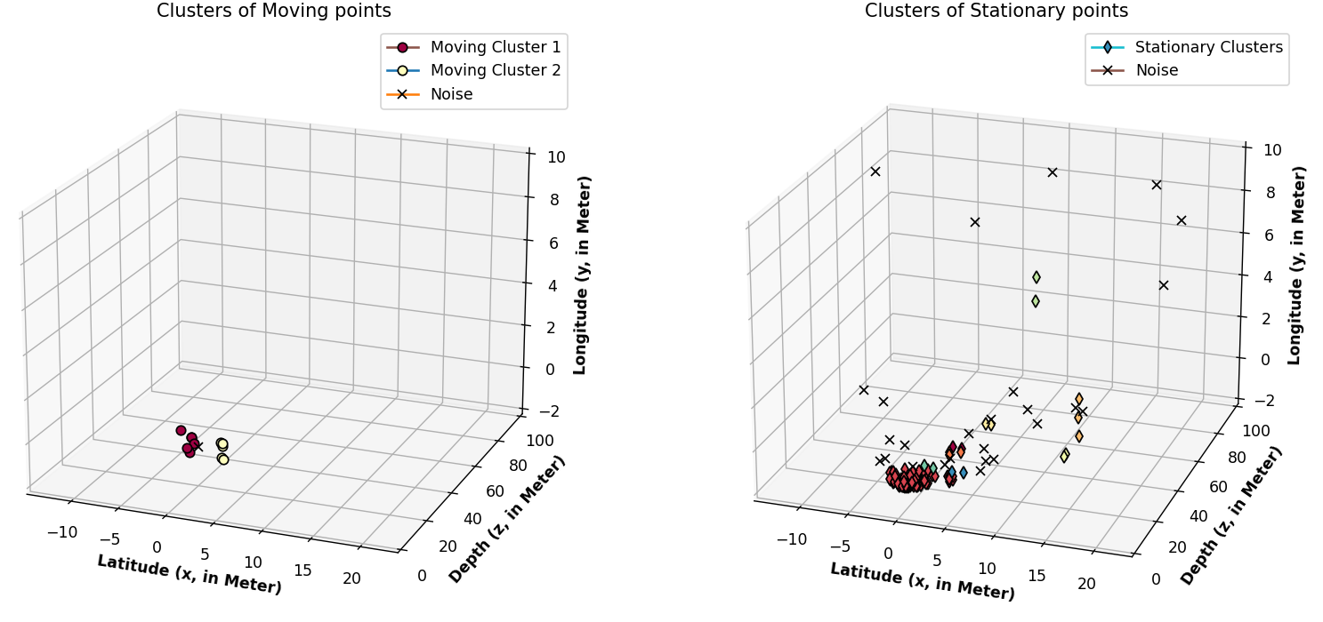
Shows the clusters Identified by applying DBSCAN on the point cloud generated by Scenario 3

Slide 17
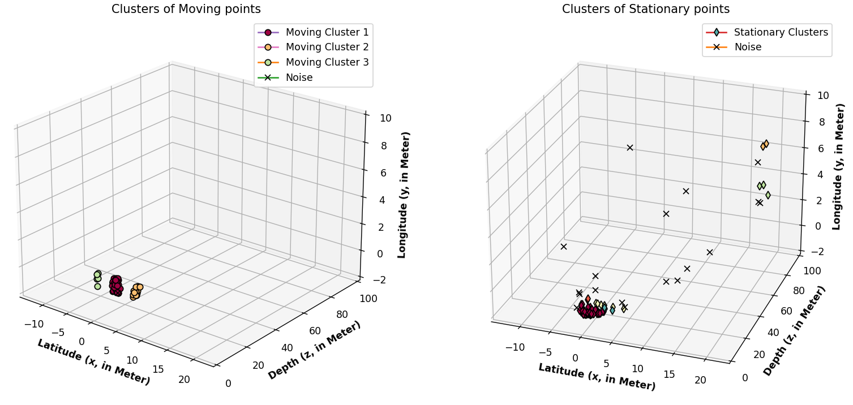
Shows the clusters Identified by applying DBSCAN on the point cloud generated by Scenario 4

Slide 18
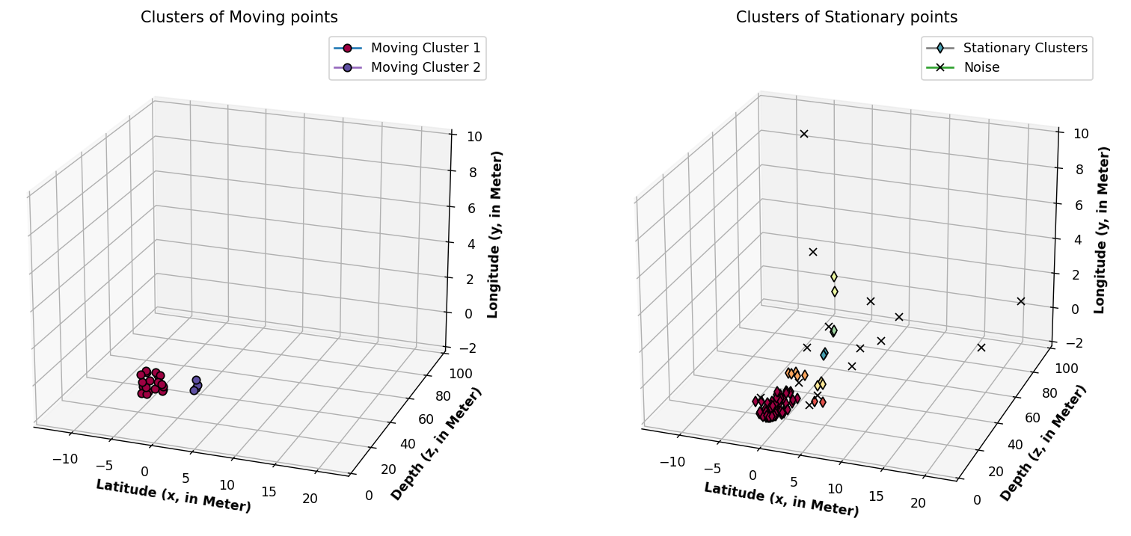
Shows the clusters Identified by applying DBSCAN on the point cloud generated by Scenario 5

Slide 19
Problems Encountered
Hardware availability
Version Mismatch on Windows PC
Carla Rendering

Slide 20
References
Nicolas Scheiner, Florian Kraus, Nils Appenrodt, Jürgen Dickmann & Bernhard Sick , „Object detection for automotive radar point clouds – a comparison,“ SpringerOpen, 2021.
Nicolas Scheiner, Ole Schumann, Florian Kraus, Nils Appenrodt, Jürgen Dickmann, Bernhard Sick, „Off-the-shelf sensor vs. experimental radar - How much resolution is necessary in automotive radar
] A. Sharma, „How to Master the Popular DBSCAN Clustering Algorithm for Machine Learningclassification?,“ IEEE, 2020.

Slide 21
Thank You

